Slide 1

Supervised ML-
Regression Capstone Project
Yes Bank-Stock Price Prediction

Slide 2
Introduction
“All there is to investing is picking good stocks at good times and staying with them as long as they remain good companies.” -Warren Buffett
The stock market is known for being volatile, dynamic, and nonlinear. Accurate stock price prediction is extremely challenging because of multiple (macro and micro) factors, such as politics, global economic conditions, unexpected events, a company’s financial performance, and so on.
In the era of big data, deep learning for predicting stock market prices and trends has become even more popular than before.
Yes Bank is an Indian bank headquartered in Mumbai, India and was founded by Rana Kapoor and Ashok Kapoor in 2004.
In 2018 the Enforcement Directorate (ED) has alleged that Yes Bank co-founder Rana Kapoor and Dewan Housing Finance Limited (DHFL) promoters Kapil and Dheeraj Wadhawan siphoned off funds worth ₹ 5,050 crore through suspicious transactions.
In this project we will be studying the stock price pattern from the inception of the Yes Bank Stock and the effects of the alleged 2018 fraud case of Rana Kapoor on the stock price.

Slide 3
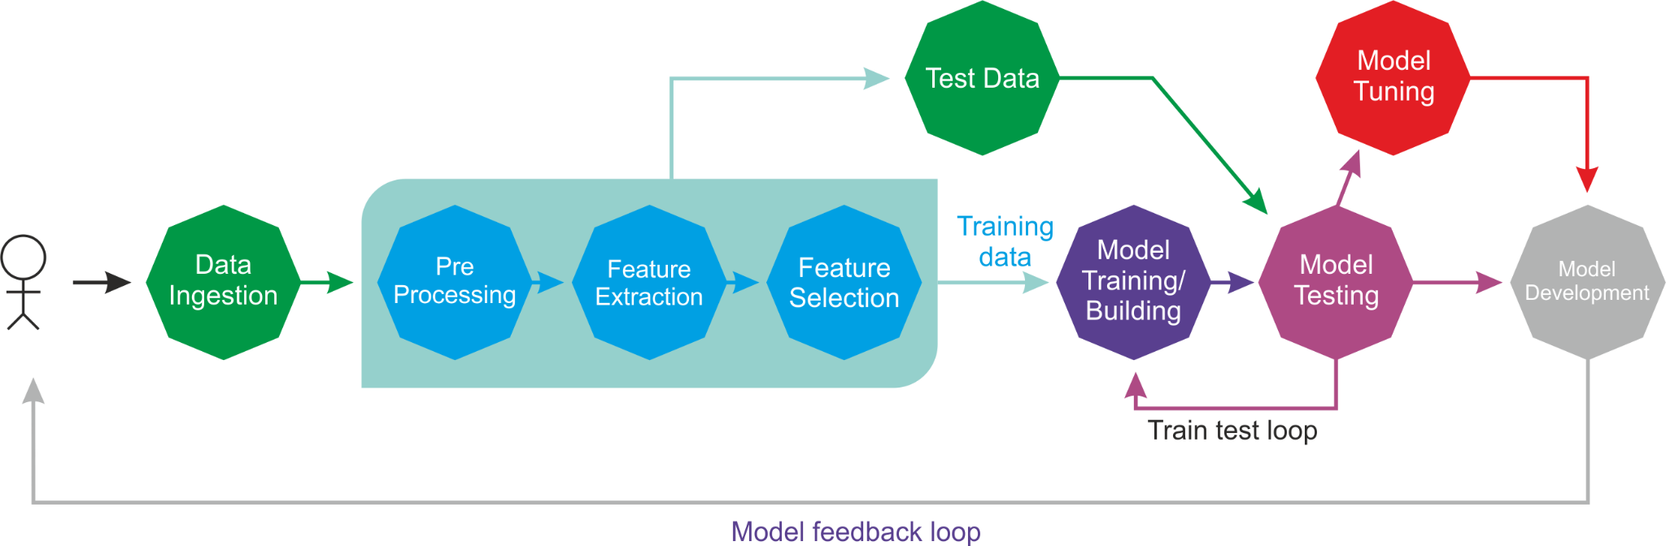
Workflow

Slide 4
Features
This data has 185 rows and 5 columns
-> Date:-A trade date refers to the month, day, and year that an order is executed in the market.
-> Open:-It is the price at which the financial security opens in the market when trading begins.
-> High:- the highest price at which a stock traded during the course of the trading day
-> Low:-the lowest price that a stock trades in that day.
-> Close:-the last level at which it was traded on any given day.

Slide 5
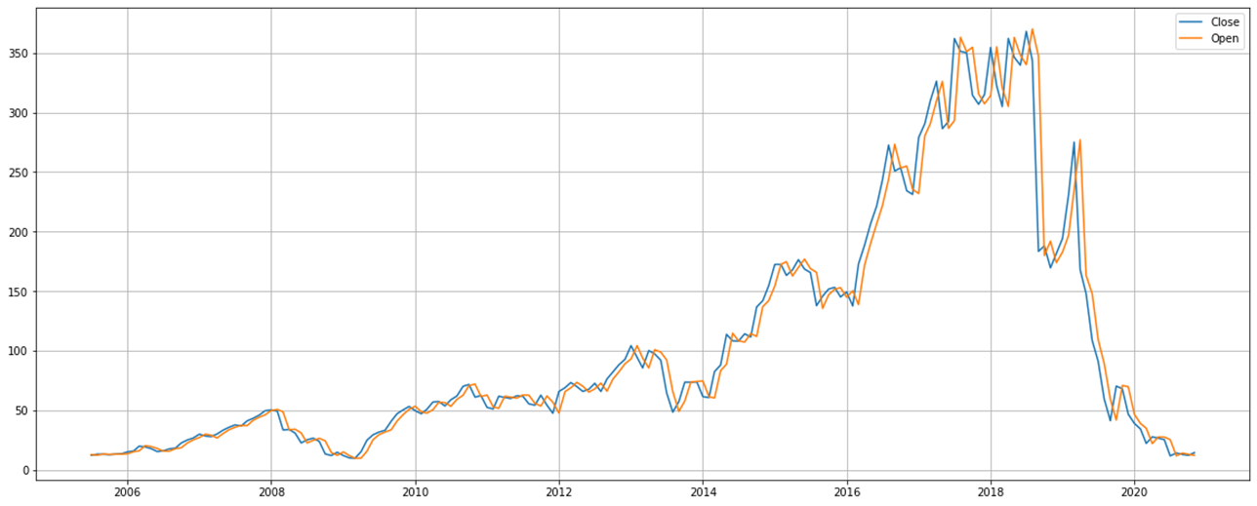
Year wise Study Open/Close
It’s seen that the Opening value of the stock Price has a steady growth since its inception till 2018. A total growth of around 900%. Then after the fraud case there is steep fall post 2018.

Slide 6
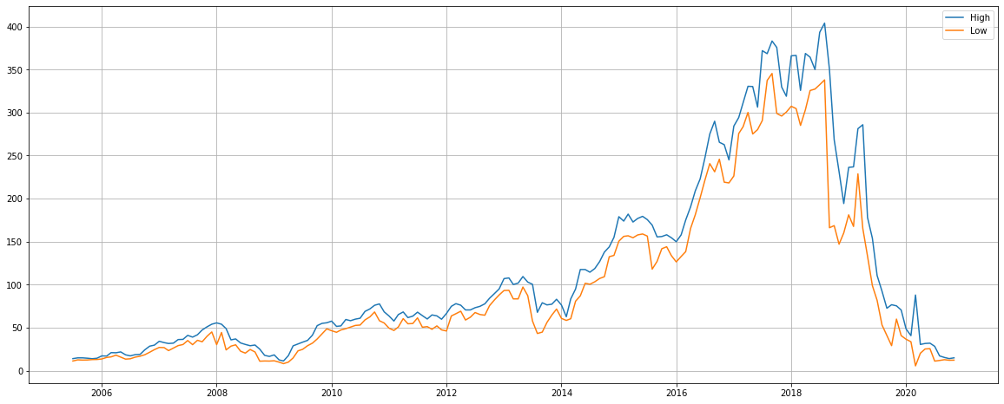
Year wise Study High/Low
The Growth pattern shadows that of the Open/Close pattern. A steady growth since its inception till 2018 and then a steep fall post the alleged fraud case.

Slide 7
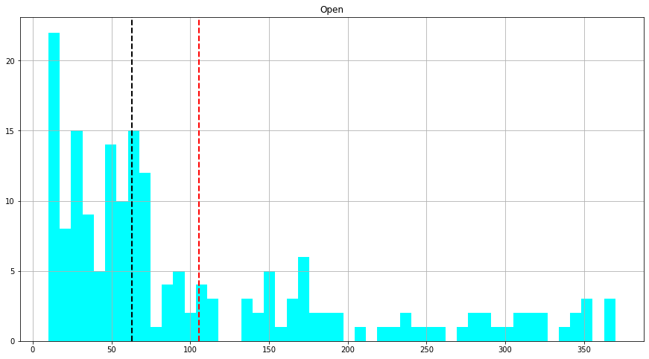
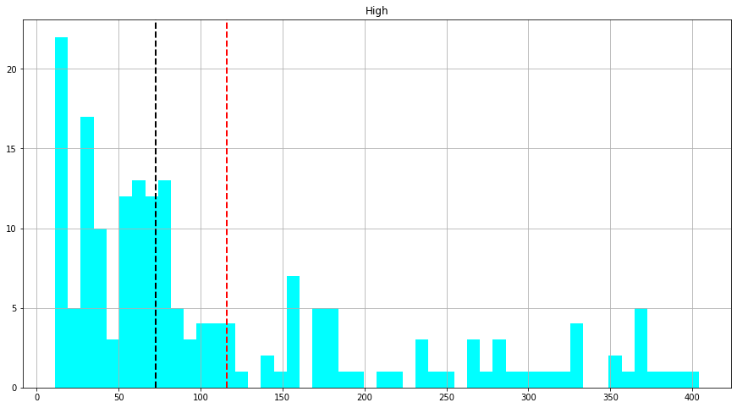
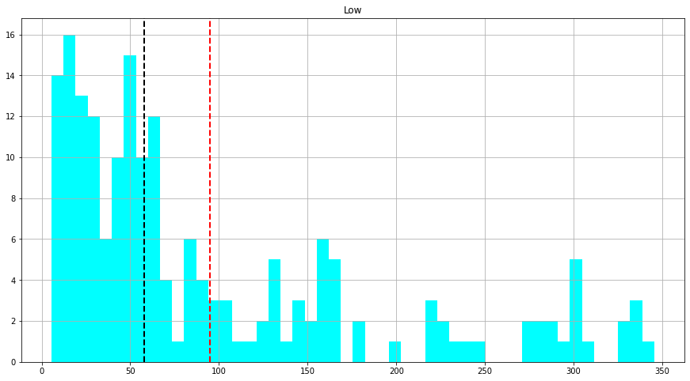
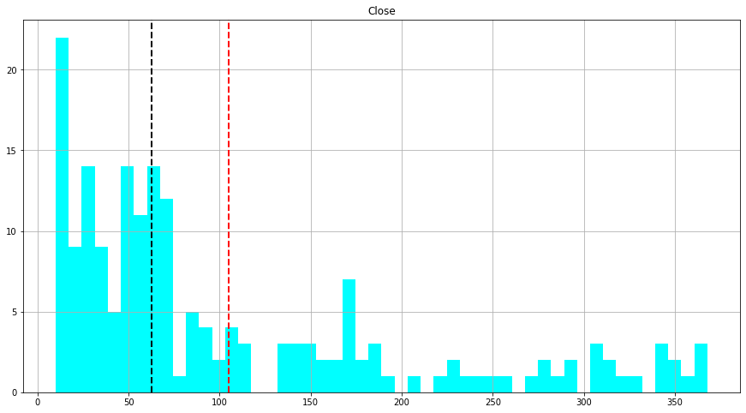
Data Distribution Before Normalization
Data isn't evenly distributed. The difference between the mean and the median is high. Thus normalization of data is needed.

Slide 8
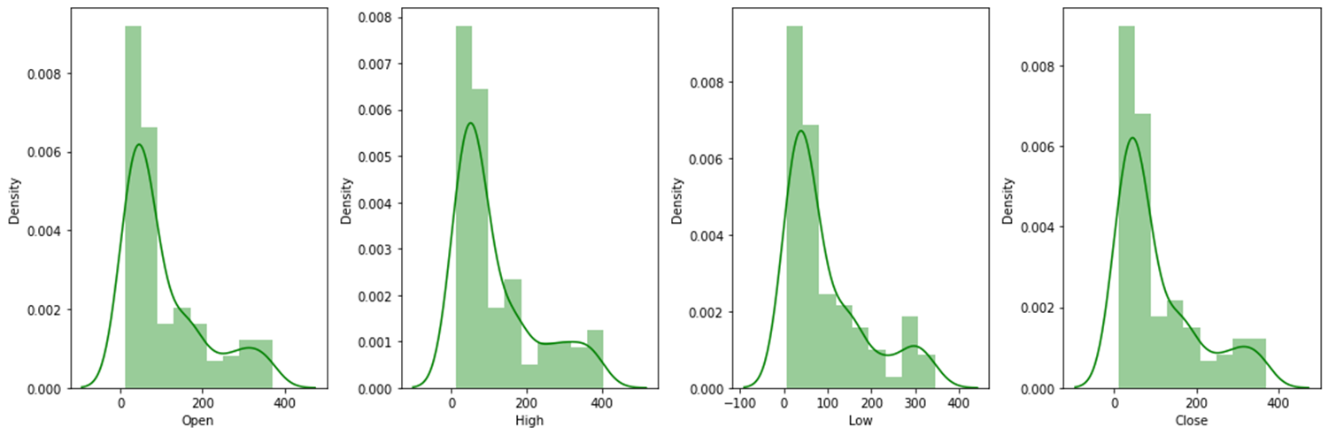
Data distribution graph before normalization
Data is Positively Skewed

Slide 9
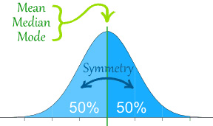
Normalization
Data normalization is all about arranging data efficiently inside a
database.
This improves the accuracy and integrity of your data, while making
the database easier to navigate.
The log transformation is used to transform skewed data to
approximately conform to normality.

Slide 10
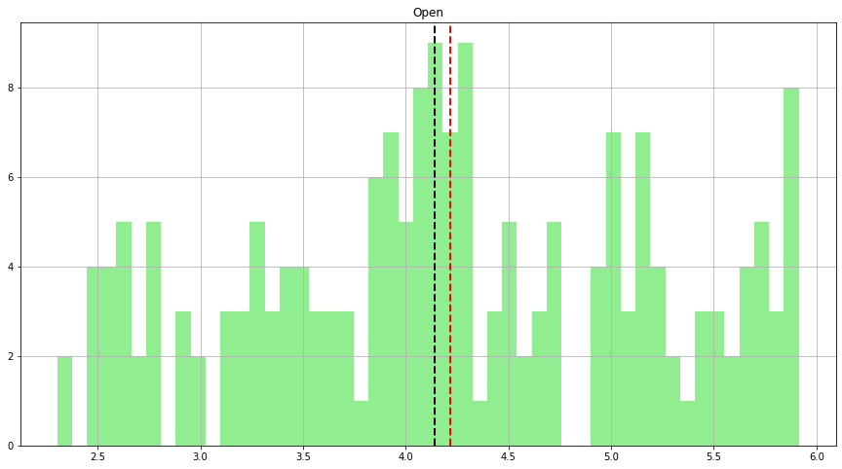
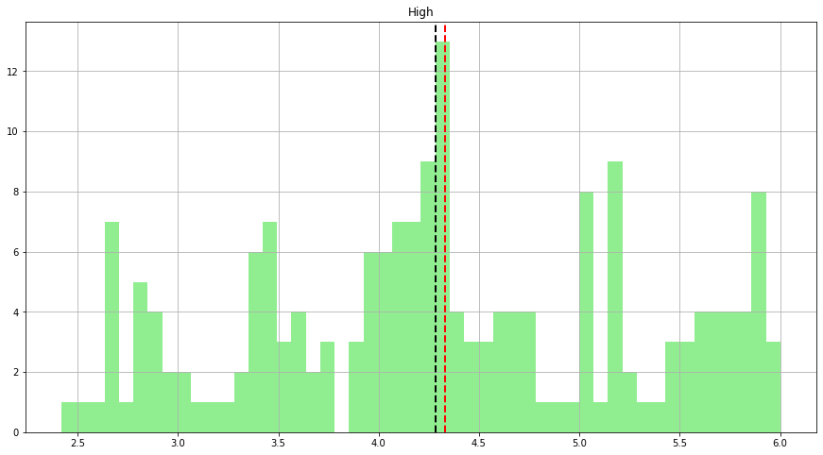
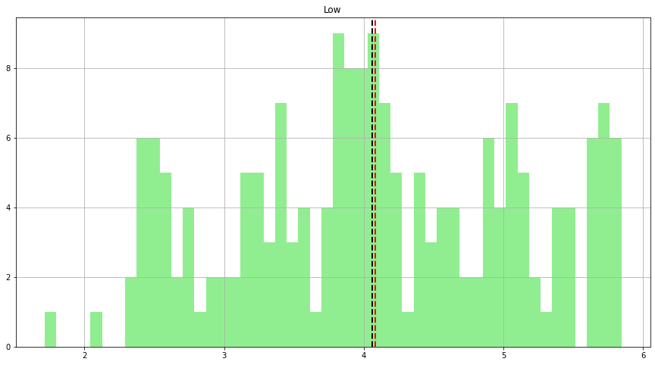
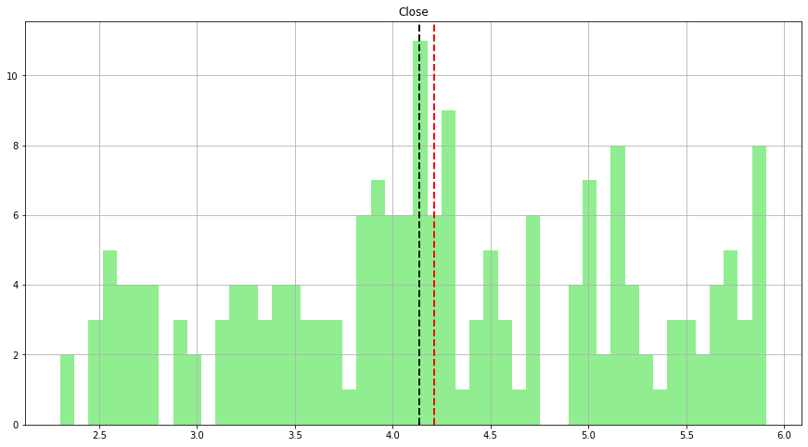
Data Distribution After Normalization
Normalized the data using the Log Transformation.Also the difference between Mean-Median is minimalized.

Slide 11
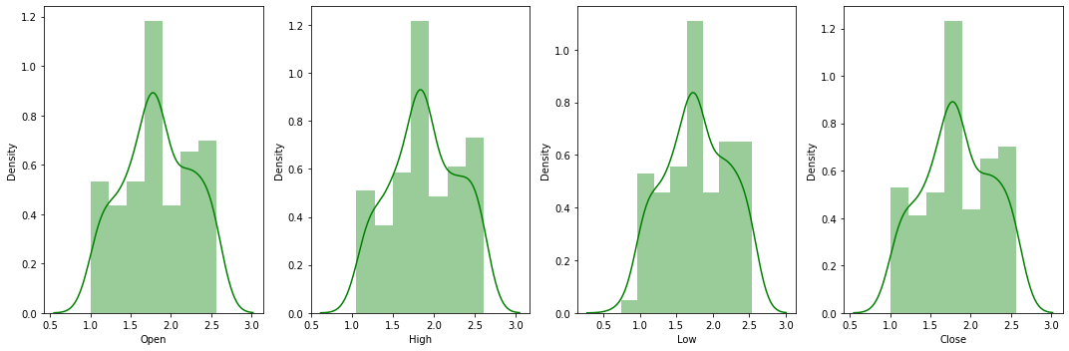
Data distribution graph after normalization
Post Log Transformation, data is Uniformly distributed. Normal Bell curve achieved.

Slide 12
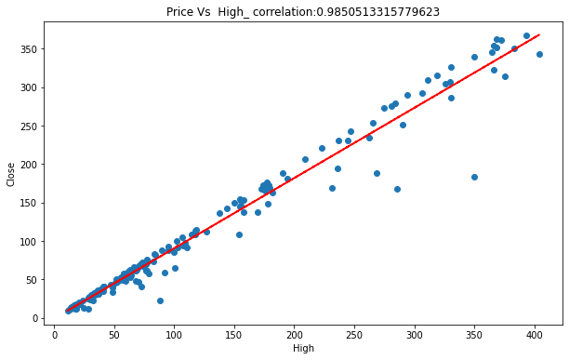
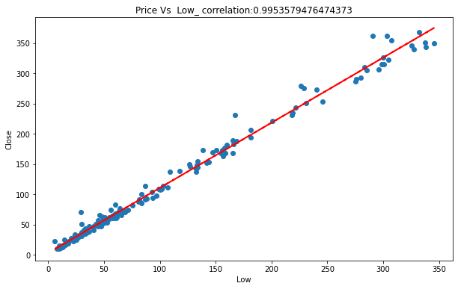
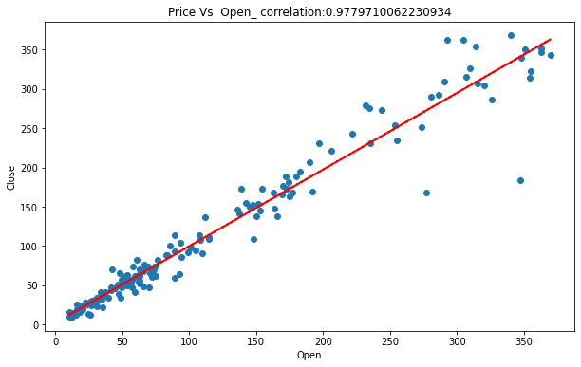
Correlation Graphs
High Correlation between the dependent and independent Variables.

Slide 13
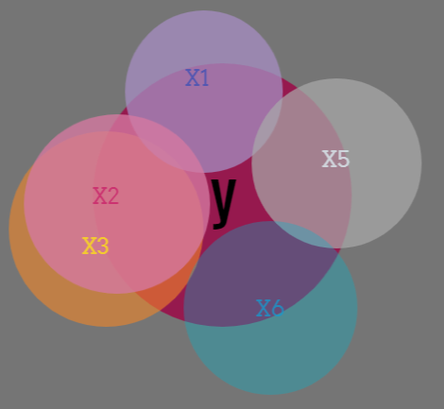
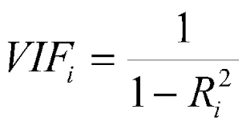
Multicollinearity And VIF
Multicollinearity is a statistical concept where several independent variables in a model are correlated.
A variance inflation factor (VIF) is a measure of the amount of multicollinearity in regression analysis.

Slide 14
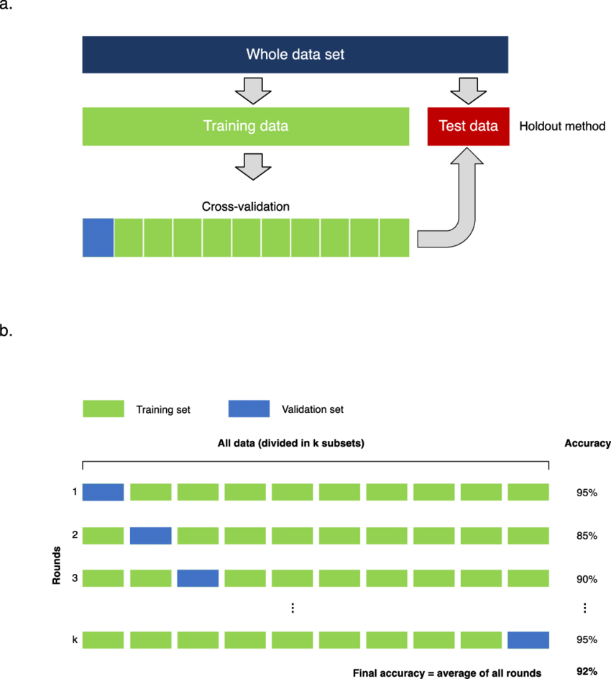
Train Test Model
Train/Test is a method to measure the accuracy of your model.
Cross-Validation is a statistical method of evaluating and comparing learning algorithms by dividing data into two segments: one used to learn or train a model and the other used to validate the model.
Hyperparameter tuning is choosing a set of optimal hyperparameters for a learning algorithm. A hyperparameter is a model argument whose value is set before the learning process begins.

Slide 15
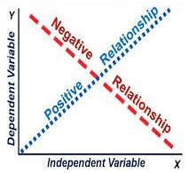
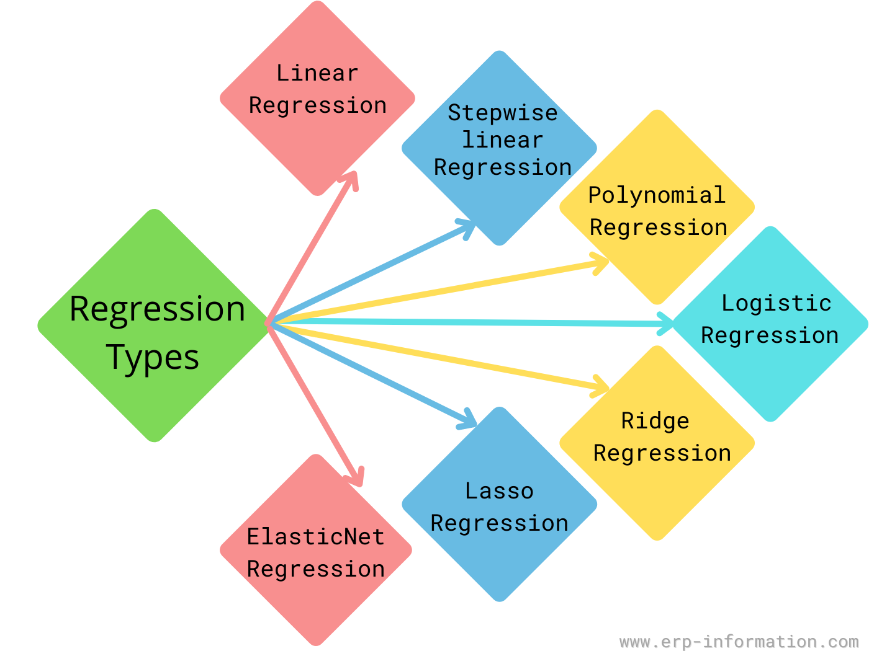
Model Training
Regression is a statistical method used in finance, investing, and other
disciplines that attempts to determine the strength and character of
the relationship between one dependent variable (Close) and a
series of other variables (High,Low,Open).
Model training is the phase in the data science development lifecycle
where practitioners try to fit the best combination of weights and bias
to a machine learning algorithm to minimize a loss function over the
prediction range.

Slide 16
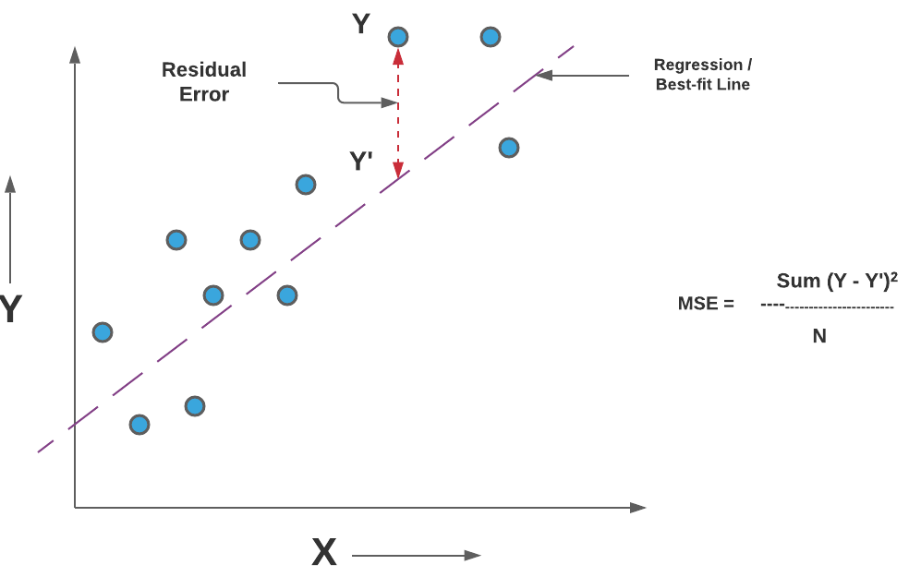
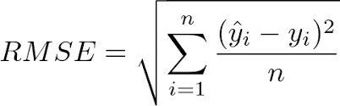
Matric Comparison Features
MSE:- Mean squared error (MSE) measures the amount of error in
statistical models.It assesses the average squared difference
between the observed and predicted values.
RMSE:-Root-mean-square Error(RMSE) is used to measure
the differences between values predicted by a model and the
values observed.

Slide 17
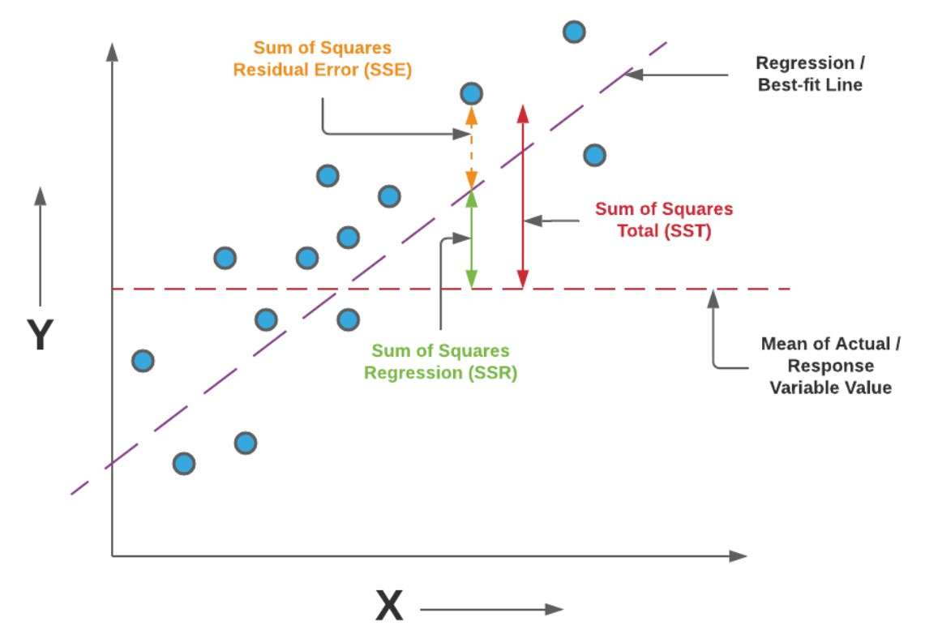
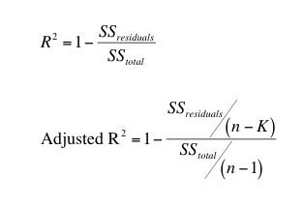
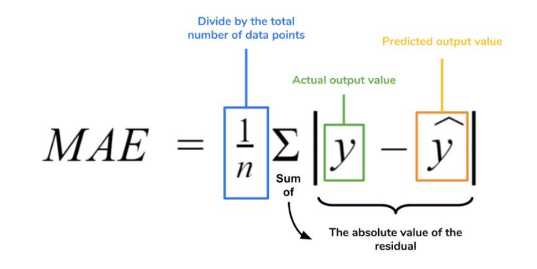
Matric Comparison Features
R2:-R-squared (R2) represents the proportion of the variance for
a dependent variable that's explained by an independent variable
or variables in a regression model.
Adjusted R2:-Adjusted R2 is a corrected goodness-of-fit
(model accuracy) measure for linear models.
MAE:-Mean Absolute Error (MAE) to the magnitude of difference
between the prediction of an observation and the true value of
that observation.RMSE is the Root of the Mean of the Square of Errors

Slide 18
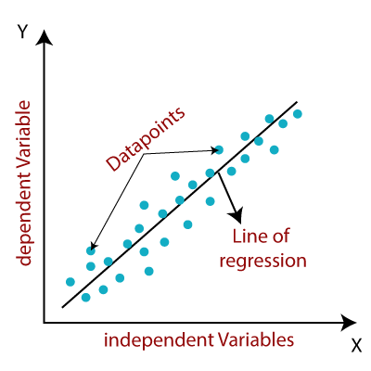
Linear Regression
Linear regression is used to model the relationship between two
variables and estimate the value of a response by using a
line-of-best-fit.
This calculator is built for simple linear regression, where we study
the independent features Open, High and Low and how the dependent
feature Close response to it.

Slide 19
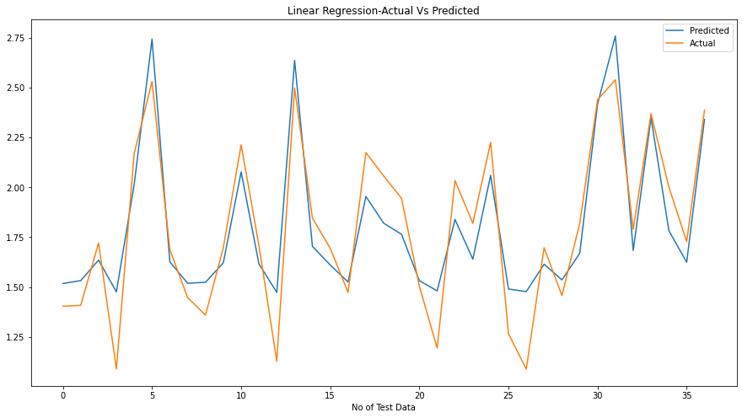
Linear regression graph
MSE:-0.031583
MAE:-0.151285
RMSE:-0.177715
R2:-0.822570
Adjusted R2:-0.806440

Slide 20
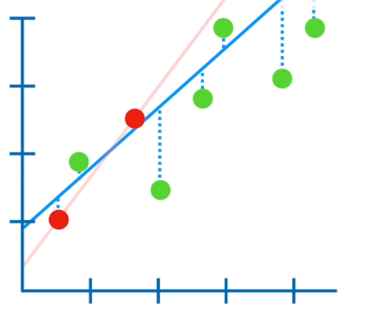
Ridge regression
Ridge regression is a specialized technique used to analyze multiple regression data that is multicollinear in nature.
Regression stays the same, but in regularization, the way the model coefficients are determined is different.
The main idea of ridge regression focuses on fitting a new line that does not fit.

Slide 21

Ridge regression graph
MSE:- 0.031685
MAE:- 0.151477
RMSE:- 0.178001
R2:- 0.821997
Adjusted R2:-0.805815

Slide 22
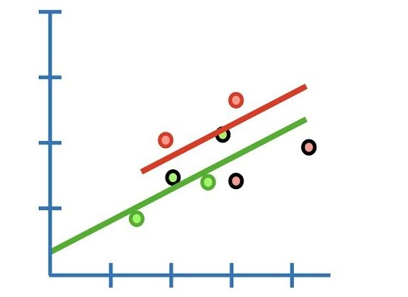
Lasso Regression
Lasso regression is a regularization technique over regression
methods for a more accurate prediction.
This model uses shrinkage. Shrinkage is where data values are
shrunk towards a central point as the mean.
The lasso procedure encourages simple models with fewer
parameters .

Slide 23

Lasso Regression Graph
MSE:- 0.032040
MAE:- 0.151477
RMSE:- 0.178996
R2:- 0.820001
ADJUSTED R2:- 0.803638

Slide 24
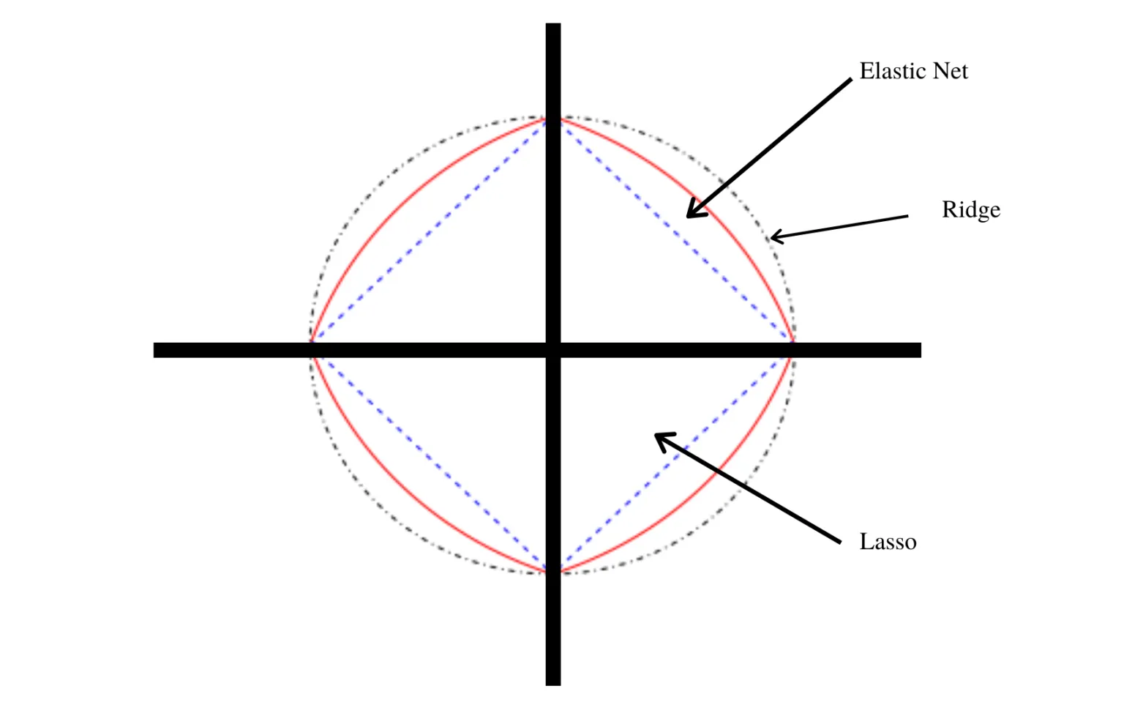
ElasticNet regression
The technique combines both the lasso and ridge
regression methods by learning from their
shortcomings to improve the regularization of
statistical models.
Elastic Net, a convex combination of Ridge and Lasso.
It first finds the ridge regression coefficients and then conducts
the second step by using a lasso sort of shrinkage of the coefficients.

Slide 25

Elasticnet regression Graph
MAE:- 0.031957
MSE:- 0.152095
RMSE:- 0.178764
R2:- 0.820468
ADJUSTED R2:- 0.804147

Slide 26
Matric Comparison
Model_Name | MSE | MAE | RMSE | R2 | Adjusted R2
Linear Regression | 0.031583 | 0.151285 | 0.177715 | 0.822570 | 0.806440
Ridge Regression | 0.031685 | 0.151477 | 0.178001 | 0.821997 | 0.805815
ElasticNet Regression | 0.031957 | 0.152095 | 0.178764 | 0.820468 | 0.804147
Lasso Regression | 0.032040 | 0.151477 | 0.178996 | 0.820001 | 0.803638

Slide 27


